Slide 1


Maternal-Guard & Life-Link
Team - TECH DIVAS
Team members :
Kanchugantala Harshitha [Team lead]
Giripogu Neha
Gokaraju Deekshitha
Kodela Manasa

Slide 2

Addressing Maternal Health Challenges Today
FROM REACTIVE TO PROACTIVE
Maternal mortality remains alarmingly high in rural areas, driven by delayed risk detection and critical conditions such as postpartum hemorrhage.

Slide 3
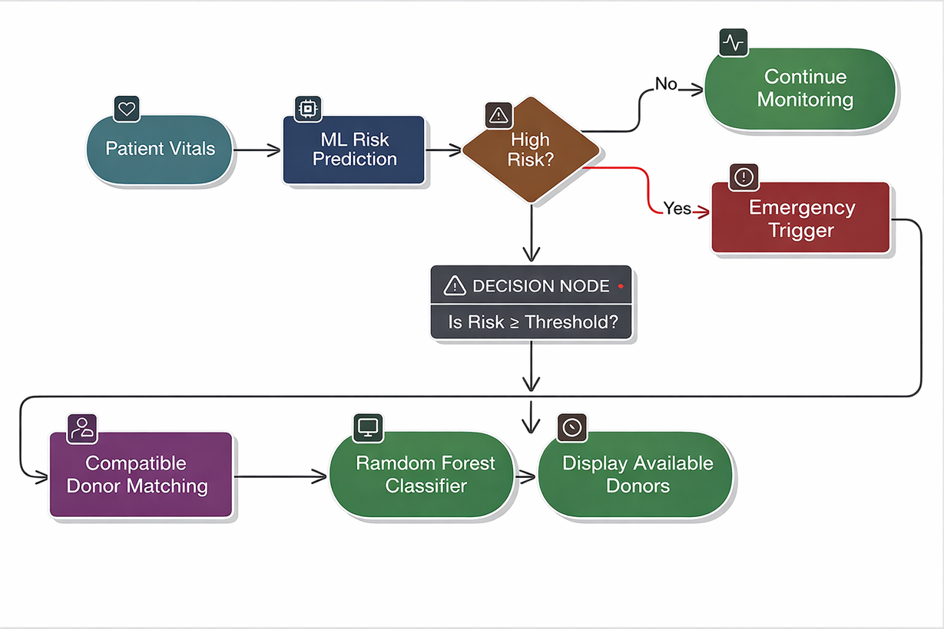
OUR AI MODEL FOR MATERNAL RISK PREDICTION
HIGH-RISK DETECTION ACCURACY
Our advanced AI-driven model uses vital sign validation and random forest classification to accurately predict maternal risks in real-time.

Slide 4
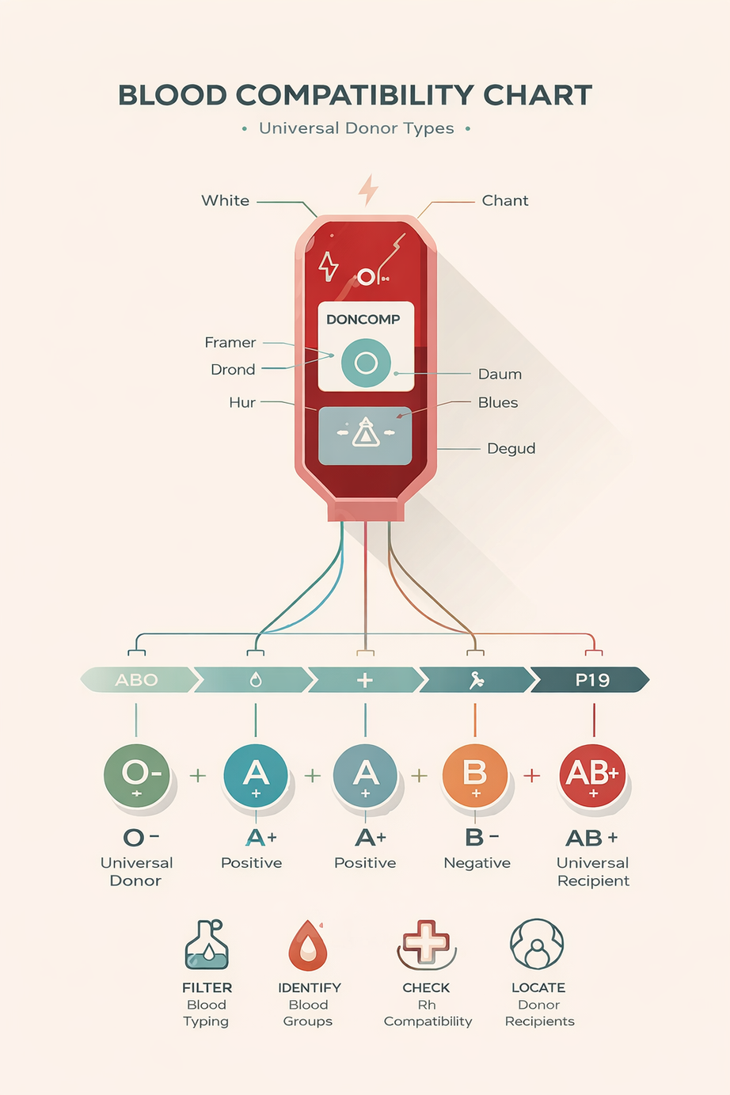
Life-Link Emergency Donor Network Overview
ONE-TAP HEMORRHAGE ALERT
Our emergency donor system uses real-time risk detection to dispatch compatible donors, ensuring rapid response during critical maternal health situations.

Slide 5

Security and Ethical Considerations Matter
TRUST AND PRIVACY
We prioritize data anonymization and donor privacy, ensuring consent toggles protect identities while reducing bias and false alerts.

